Slide 1




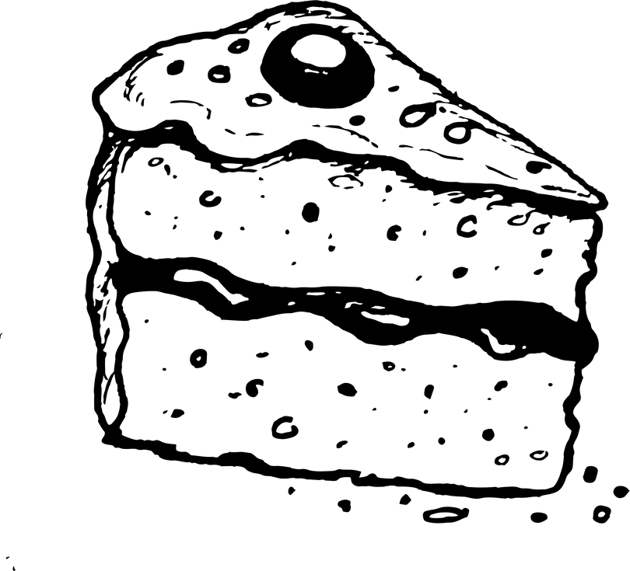





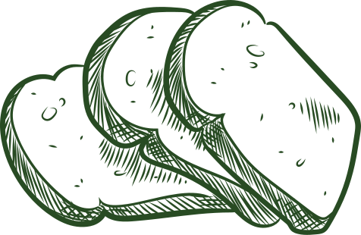




The Dessert Spot
"The Dessert Spot Bakery" is a Bakery shop where you can enjoy delicious treats made with love and the best ingredients , where every bite tells a story.
The Dessert Spot
The Dessert Spot

Slide 2

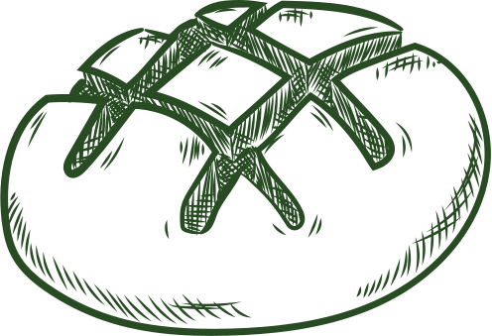



Our Agenda
Objectives & smart goals
Target
Audience
Buyer personas
Competitive analysis
Our analysis
Platforms
Content type
Content calender

Slide 3




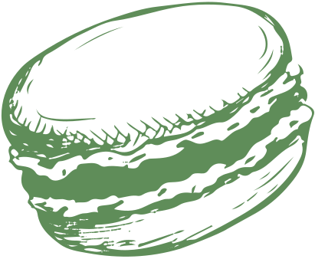
SMART Goals:
-Making an interesting menu, new items like sugar-free-low- calorie
-Be on social media platforms like Facebook and TikTok.
-Customer satisfaction through interaction with customers on platforms and feedback and reviews on social media.
-Having our own offline site and packaging.
1. Brand Awareness
-Increase followers : gain 1000 new followers on Instagram and 3000 on Facebook within 3 months.
-Impressions : Achieve 10,000 impressions across all social media platforms monthly.
2. Customer Engagement
-Content interaction : generate 2000 likes , 500 comments and 500 shares monthly.
-Story views : Achieve 2000 views on Instagram stories every week.
-Poll participation : get 500 responses on Instagram or Facebook polls each month.
-Engagement rate : maintain an engagement rate of at least 10% per post.

Slide 4
SMART Goals
3. Sales and Conversions
- Online orders : drive 30% of total monthly dessert sales through social media promotions..
-Campaign performance : Generate 200 sales from a single paid ad campaign.
4. Content Creation
- Post frequency : publish 6-7 high quality stories per week and 3-4 posts including photos , videos and reels.
- Video views : Achieve 15000 views per reel or tiktok within 7 days of posting.
- User-generated content : Encourage customers to share 15-20 tagged photos of your desserts within the first 3 months.

Slide 5
SMART Goals
5. Customer Satisfaction Goal:
-Maintain a rating of 4.5 stars or higher through high quality products.
-Excellent customer service.
-Efficient ordering and delivery process.
-Quality control and hygiene and customer feedback and reviews within the first 3 months

Slide 6
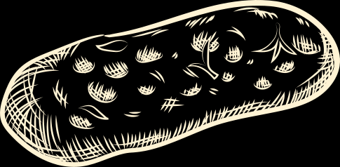
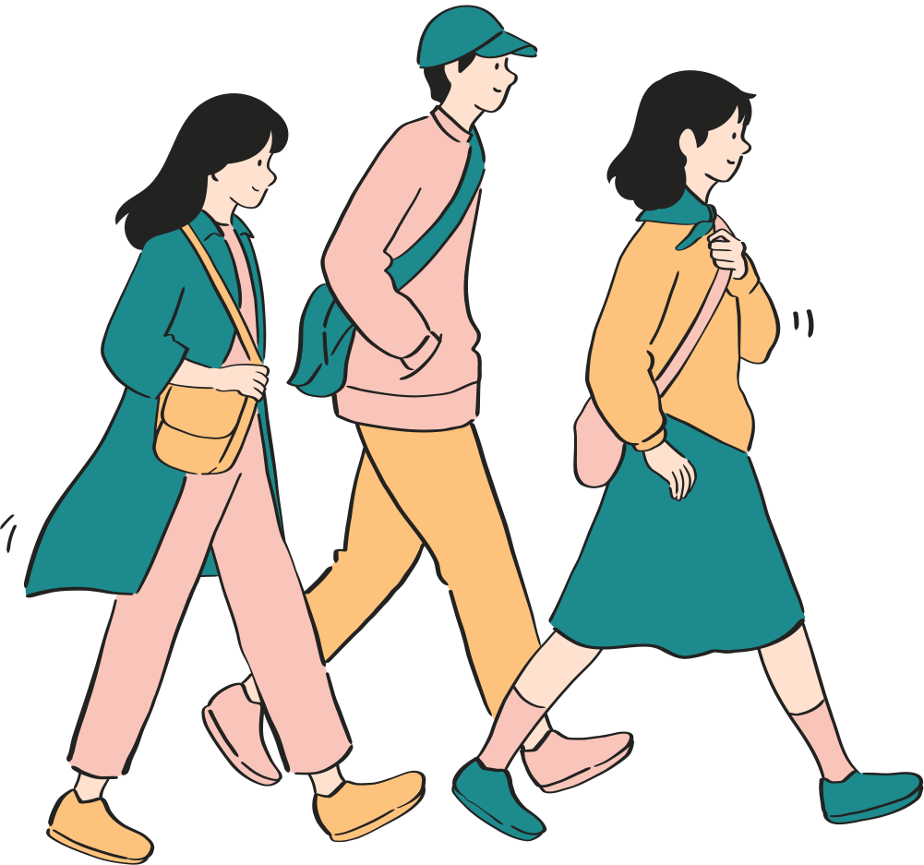
Audience
Primary Target Audience Segments
1. Millennials and Gen Z (18–35 years old)
Characteristics:
-People who spend most of their time on social media.
-People who are attracted to content attractive online content.
Behavior:
-Prefer to order food delivery and try restaurants to dine out.
-Try new flavors and new food.
Marketing Channels:
- Instagram , TikTok , and Facebook.

Slide 7
Audience
2. Families with Children (30–45 years old)
Characteristics:
-Parents wanting to offer to offer the best treats to their kids with the best qualities and the best prices.
Behavior:
-Purchase cakes and desserts for birthdays or school events.
-Prefer to family sized packages.
Marketing Channels:
-Facebook , Instagram and TikTok.

Slide 8
Audience
3. Professionals and Office Workers (25–50 years old)
Characteristics:
-Busy individuals people look to buy convenient dessert.
-They often buy desserts as snacks or dessert for team celebration.
Behavior:
-Use platforms like talabat and otlob.
Marketing Channels:
-Facebook , Instagram and TikTok.

Slide 9




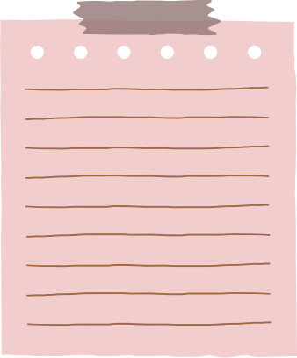
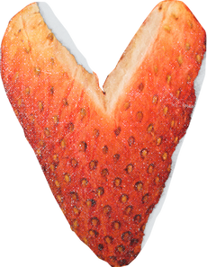


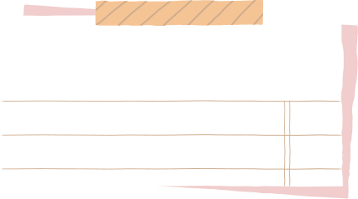
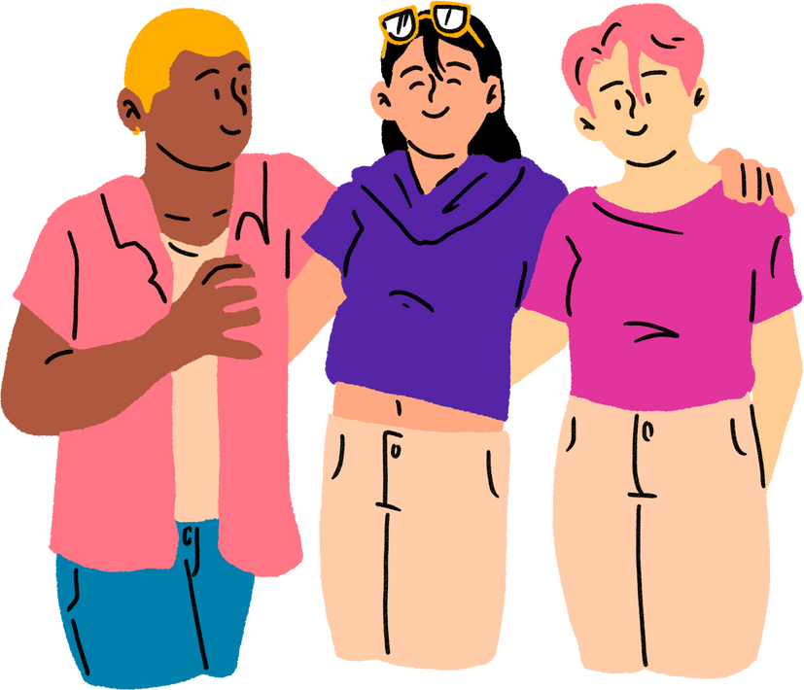
Buyer persona
SOHA
Challenges: Soha needs to plan desserts for family celebrations. She may struggle to find reliable options that fit her vision.
Used platforms: Facebook
Instagram
Tiktok
35 years old , from middle classworks as a teacher ,a mother of 2 boys.
sweets lover specially chocolate cakes, spends her free time on facebook and tiktok.
Buyer behaviour: Online Ordering & Delivery:
Due to her busy schedule, Soha looks for bakeries that offer easy-to-use online ordering systems and home delivery services.

Slide 10
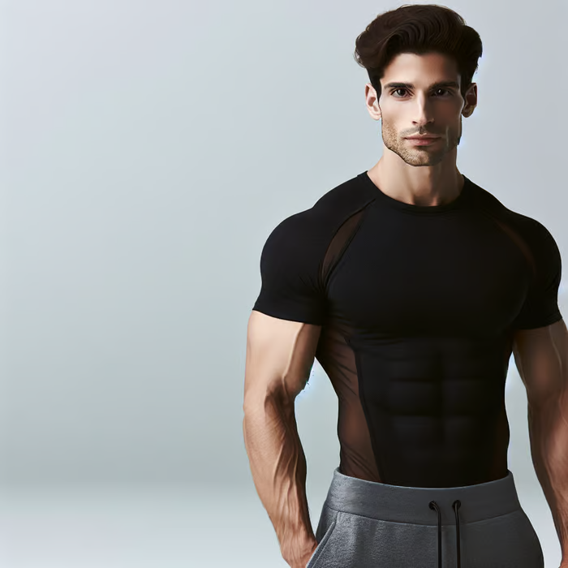
Buyer persona
SHADY
Challenges: He needs desserts that are both healthy and satisfying without compromising his fitness goals.
Used platforms: Facebook
Instagram
35 years old , from middle classworks as a teacher ,a mother of 2 boys.
sweets lover specially chocolate cakes, spends her free time on facebook and tiktok.
20 years old . a college student from the high class.
A gym freak who likes to post on instgram about his gym practice and the healthy food to make and where to buy healthy snacks.
Buyer behaviour: He may be influenced by food bloggers, influencers, or gym communities when deciding where to buy his healthy desserts.

Slide 11

Buyer persona
SANDY
Challenges: Finding high quality, unique desserts:
Sandy seeks to provide her followers with the best quality of desserts she may struggle to find bakeries with best quality that stand out from the crowd.
Used platforms: Facebook
Instagram
35 years old , from middle classworks as a teacher ,a mother of 2 boys.
sweets lover specially chocolate cakes, spends her free time on facebook and tiktok.
25 years old. a food blogger who likes to post about the food places with high quality to give her followers the best quality.
Buyer behaviour: Visual Appeal:
Sandy looks for desserts that are not only tasty but also look great and are perfect for sharing on social media.

Slide 12
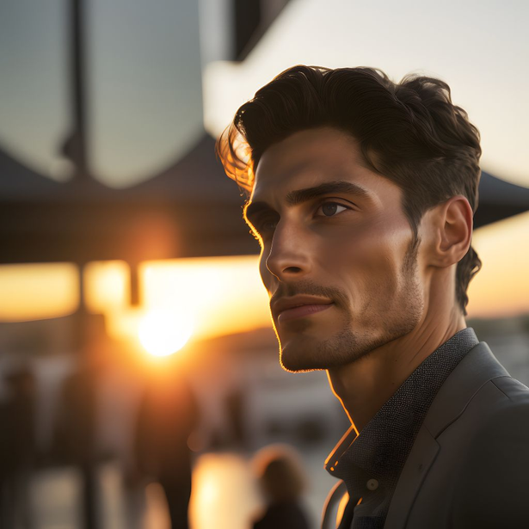
Buyer persona
HESHAM
Challenges: Family Preferences :
Hisham has three children, so it can be hard to find desserts that everyone in the family enjoys. He needs options that are suitable for everyone of his family.
Used platforms: Facebook
Instagram
35 years old , from middle classworks as a teacher ,a mother of 2 boys.
sweets lover specially chocolate cakes, spends her free time on facebook and tiktok.
38 years old bank accountant, middle class person ,and a father of 3 children , cares about giving his family the best things with reasonable prices.
Buyer behaviour: attracted by Promotions:
Hisham is likely to be influenced by special deals, discounts, or promotions when making his dessert purchases.

Slide 13
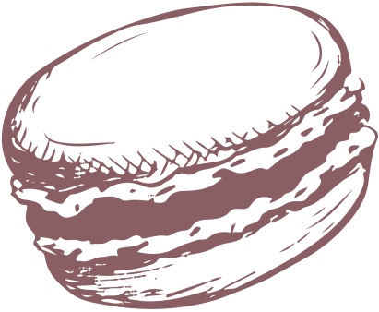




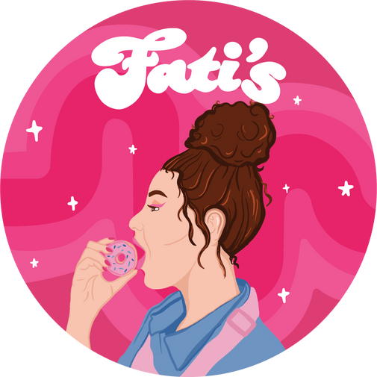



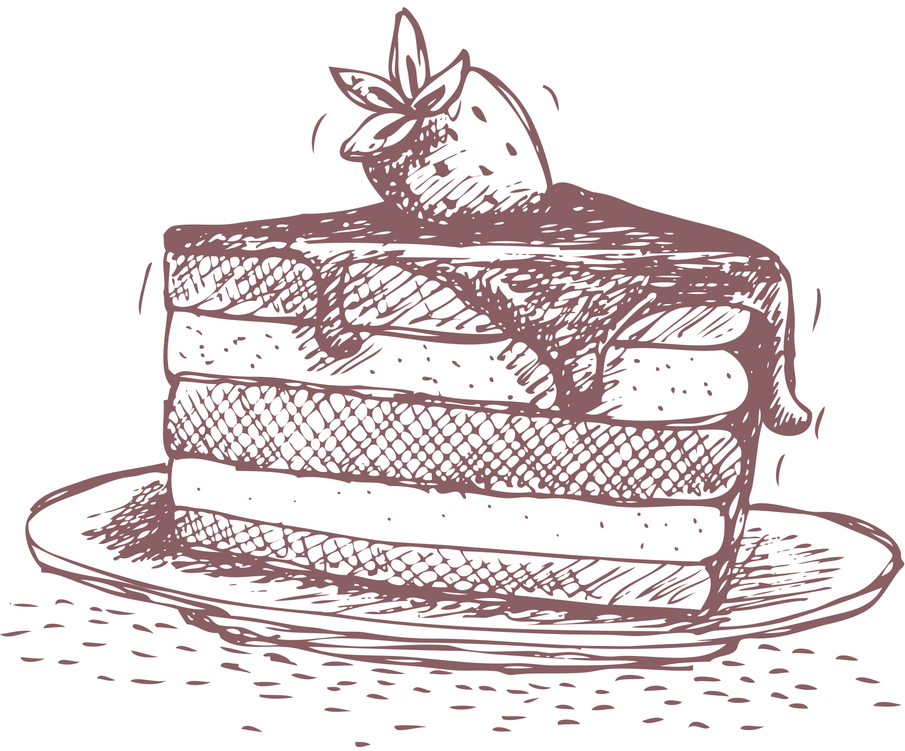
Competitive analysis
Key competitors:
-Bloombite
-Donut
-vermicelli cake
-sugar treats
-fatis
-moullies
-tamm elbyout
Others:
-bakery shops
-patisserie

Slide 14
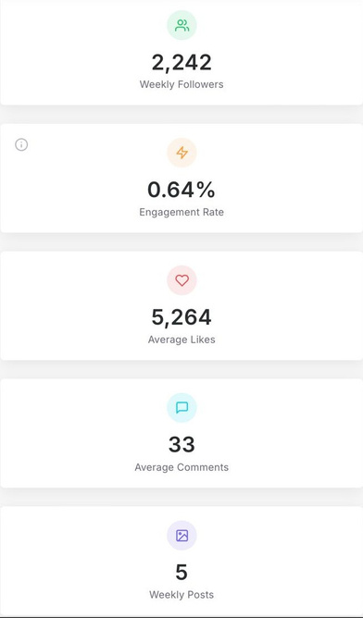
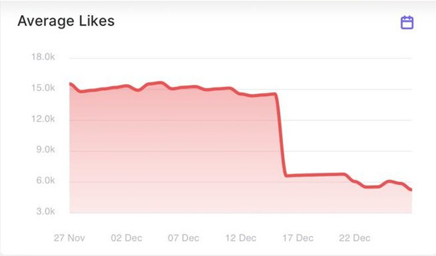
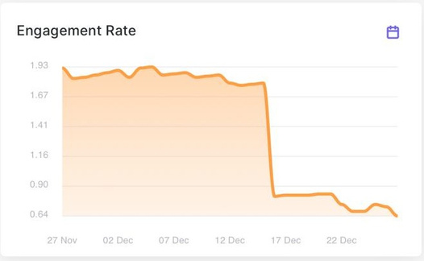
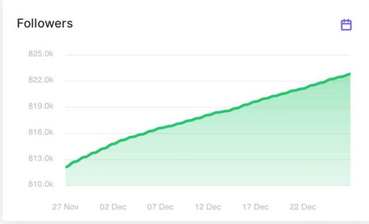
Competitive analysis
1.Fati's:
-Channel: Facebook -insta-tiktok- website #followers: 197k on Facebook - 823k Instagram #likes: 27k on facebook
-About: good about
-Posting: regularly
-#of posts: more than 15 in month.
-Paid posts: not clear
-Types of content:Reels- video- album
-Tone of voice:Friendly-funny-playful- humorous - passionate- nostalgia-cheerful
-CTA: no
-Moderation: weak
-Content: short and good
-Profile photo: good, Cover not perfect choice.
-Strength:-good existence on social media platforms-high organic reach-many channels-good reputation-many items and matching with trends.-good numbers of followers/likes/ reach-existence online and have franchise offline.-good creatives like reels, videos and designs.
-Weakness:-moderation-bad reviews-website is not friendly using-high prices-much time for order

Slide 15
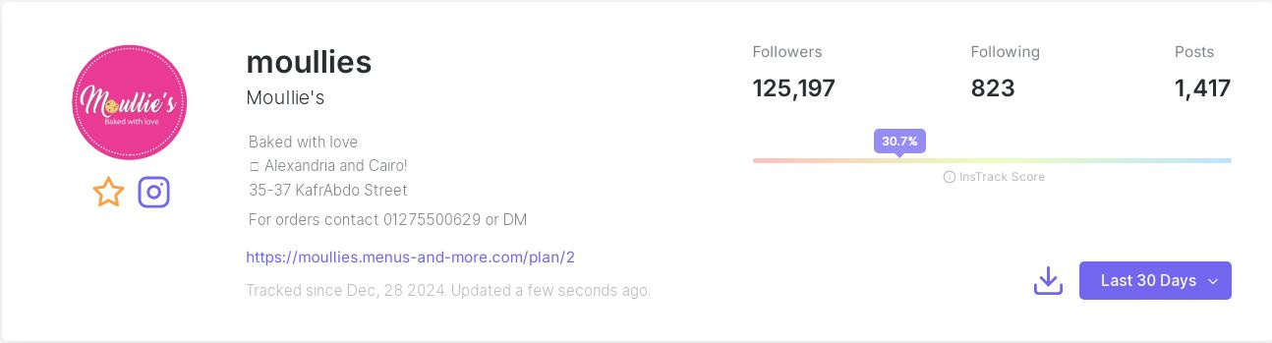
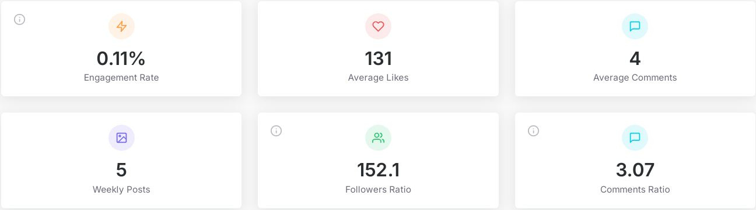
Competitive analysis
2-Mouilles:
-Channel: Facebook-insta-website
-Followers: 13 k face- 125k insta likes: 14 k
-About: no
-Posting: not regularly
-#of posts: less than 10 in month
-Paid posts: no
-Types of content: Reels-photos
-Tone of voice: as previous
-CTA: no
-Content: good short caption
-Profile: good Cover : not
Strength:-good designs, Reels with high quality.-have offline shop in Kafr abdo and online shop.-many items in menu and trending.-customized backed items for special moments and party.
-Weakness:-low reach/ engagement on social media (Facebook)
-small offline shop
-prices is high.

Slide 16
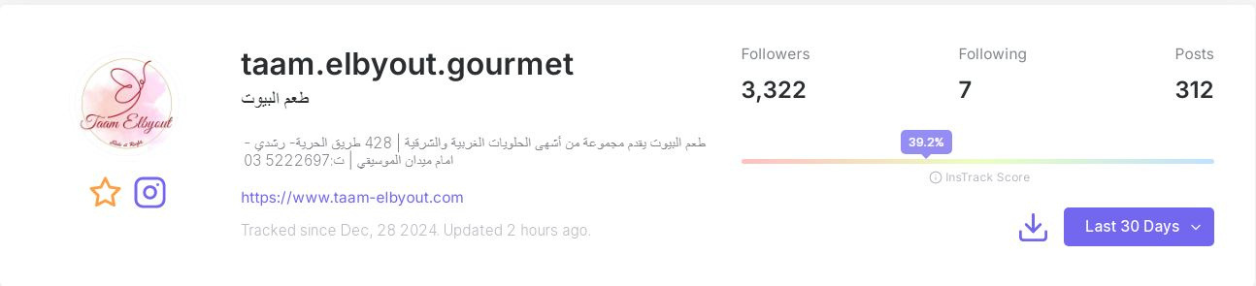
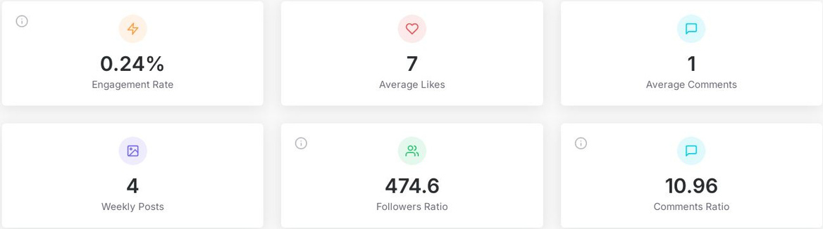
Competitive analysis
3-Taam Elbyout Gourmet:
-Channels: Facebook -Instagram- website
-followers: 43k
-likes: 43k
-About: exist and good
-Posting: not regularly
-#of posts: less than 10 in month.
-Paid posts: not
-Types of content:Reels-photo
-Content: not good
-Tone: mixed tone formal and casual and language Arabic and English
-Photo and cover: not good
-Designs: not good enough
-Strength:Good Reels and videos
-Online and offline existence:-participate in bazaar and events-good reputation-influencers and bloggers reviews
-Weakness:-quality of Designs not good

Slide 17

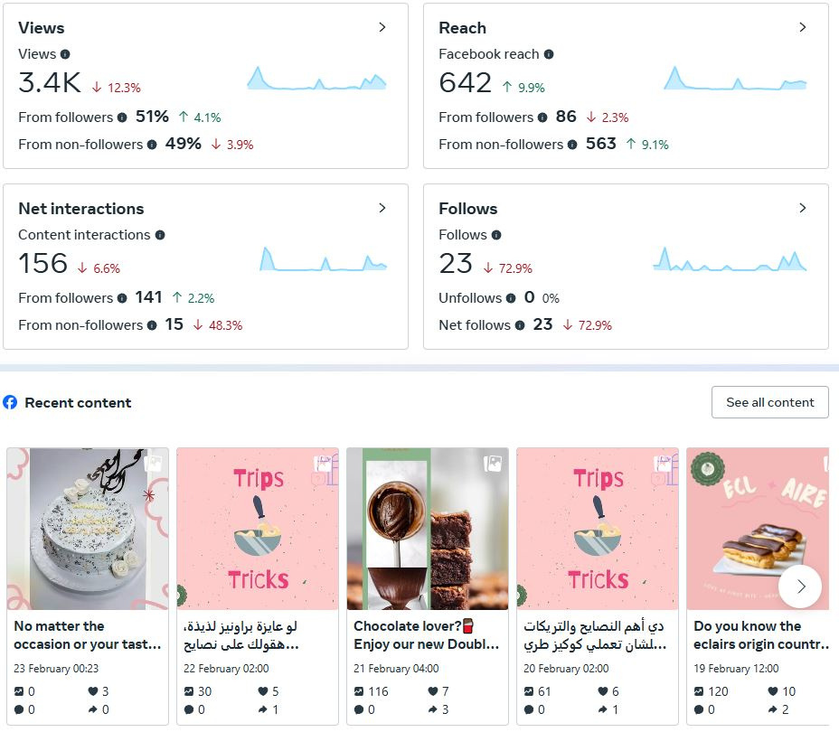
Our analysis

Slide 18

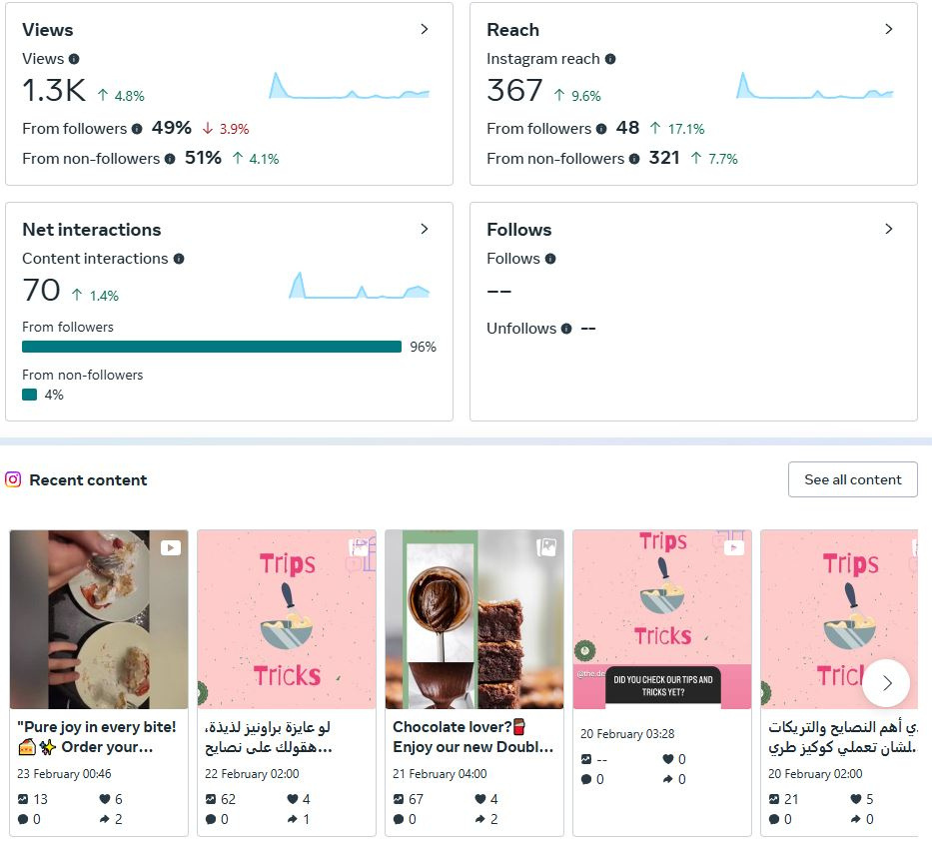
Our analysis

Slide 19
Swot analysis
swot analysis
Strength
1-Good reputation and feedback from customers
2-Convenience: Online ordering saves customers time and effort compared to visiting physical stores.
3-Customizability: Options for custom desserts can attract customers seeking personalized items for events.
4-Product varity :number of items like cakes cookies- Cinnabon -customized cake
5-good quality with good prices
6-Quality of ingredients which enhance taste
7-participate in bazaar and events.

Slide 20
Weakness
1-New brand so weak marketing,small number of likes and followers
2-Lack of Physical Presence: Customers might miss the opportunity to see and sample desserts before purchasing.
3-No offline shop,limited marketing budget
4-Limited Market Trust: New online businesses often struggle to gain trust without a physical storefront.
5-Demand of dessert might vary depending on the season.

Slide 21
Opportunities
1-Growing E-Commerce Trend: Increased internet usage and preference for online shopping in Egypt can benefit the business.
2-Seasonal Promotions: Capitalizing on local holidays, Ramadan, and wedding seasons to boost sales.
3-Introducing unique or healthier options (e.g., sugar-free, keto) can attract niche audiences.
4-Partnerships: Collaborating with event planners, cafes, or influencers for cross-promotions.
5-High Demand: Alexandria has a diverse food culture, and desserts are always in demand, especially for celebrations and special occasions.
6-Social Media Reach: The ability to promote visually appealing desserts on platforms like Instagram and Facebook can drive engagement and sales.
7-Lower Overheads: Operating online reduces costs associated with physical store rental and utilities
8-Collaboration with other local brands, cafes, events and bazaar

Slide 22
Threats
1-Economic Instability: Inflation and fluctuating costs of ingredients can impact pricing and profitability.
2-Delivery Competition: Larger platforms like Talabat dominate the market and charge high commissions.
3-Food Safety Regulations: Compliance with government health and safety standards is crucial and could pose a challenge for smaller businesses.
4-Consumer Preferences: Shifting trends and preferences may require constant innovation.
5-Negative Reviews: Poor online reviews can quickly damage reputation and sales.
6-Delivery Challenges: Maintaining the quality and presentation of desserts during delivery can be tricky.
7-High Competition: Many established bakeries and home-based businesses already operate in Alexandria.
8-Many Competitors
9-supplies (Raw materials)

Slide 23




Platforms

Slide 24
Content
-Content types:
-UGC- user-generated content
-Reels -Videos
-social media posts
-GIF
-CAROSAL
-STORIES
-INTERACTIVE CONTENT
-CASE STUDIES
-MEMES
-REVIEWS
Top Hashtags:
#The_spot_dessert #Dessert-#Dessert_lovers-#Dessert_time #Healthy-#Healthy_eating-#Healthy_food #Cake-#Cake_lovers- #Cookies _of Instagram #Cookies #Alexandria-#alexandria_egypt

Slide 25
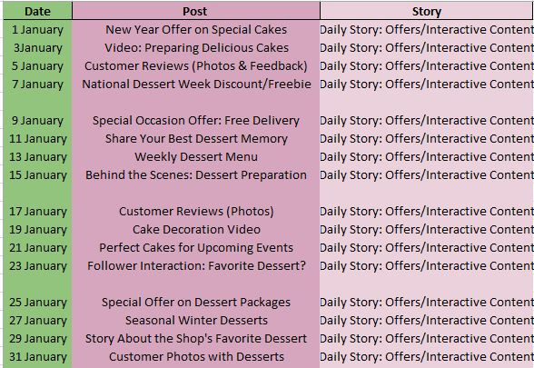
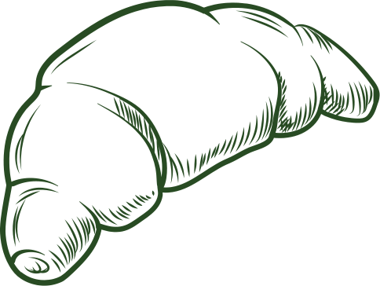


Content calender

Slide 26
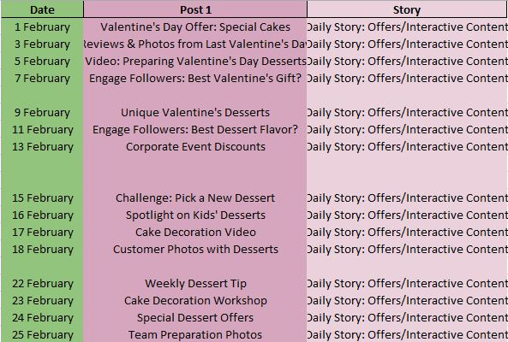
Content calender

Slide 27
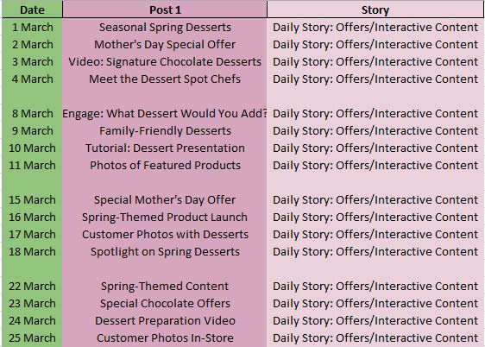
Content calender

Slide 28
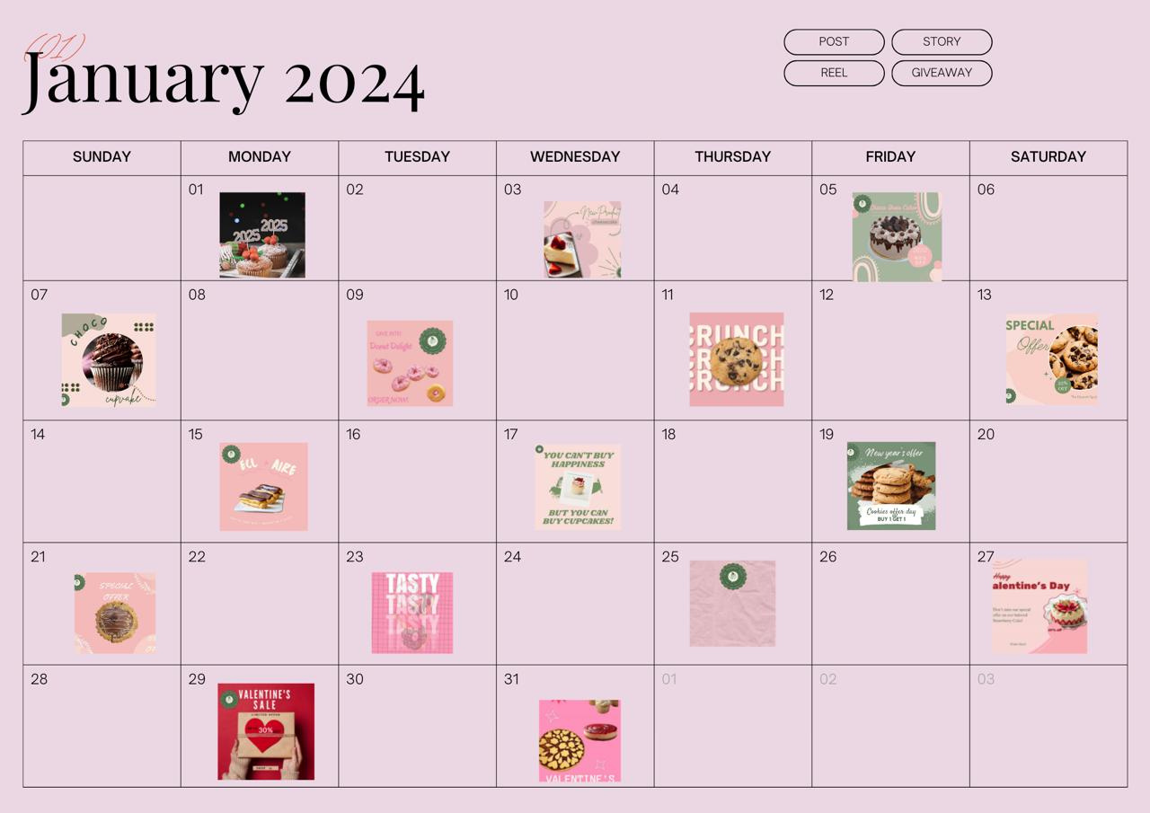
Content calender

Slide 29
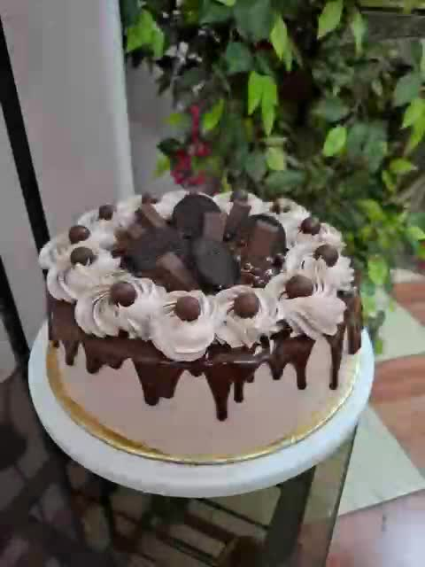
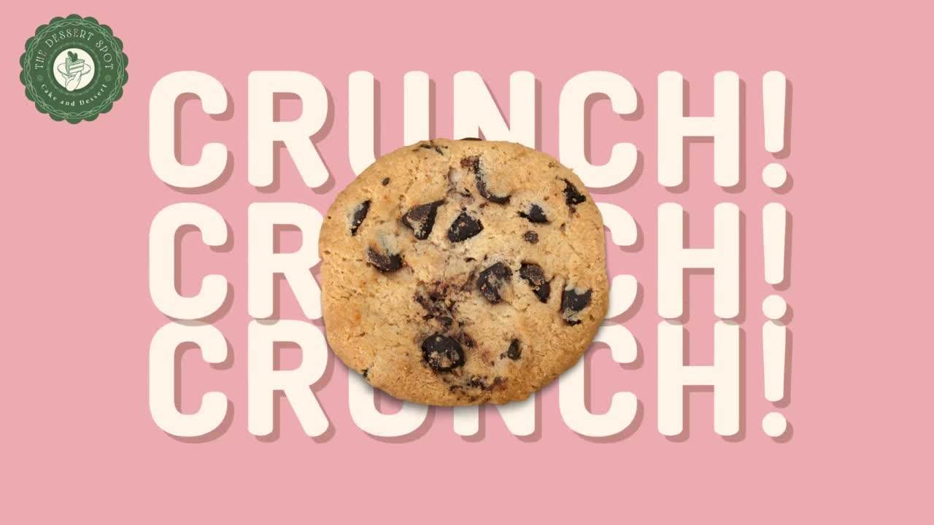
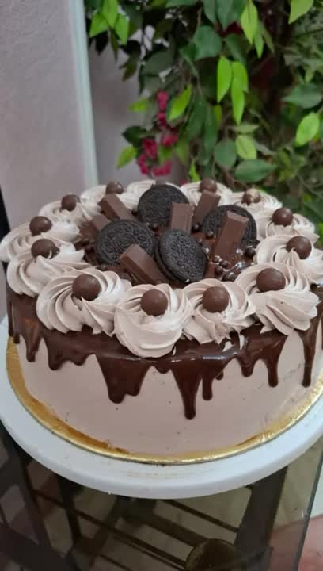

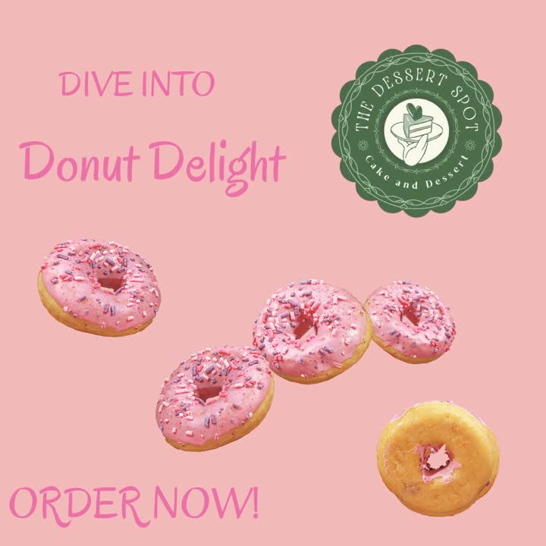
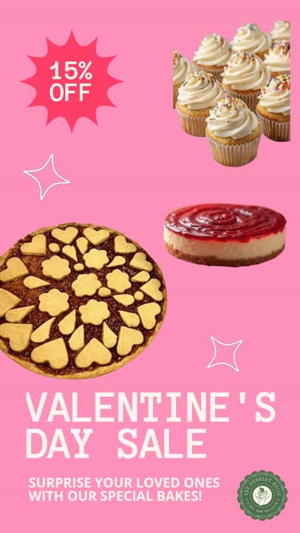
content

Slide 30
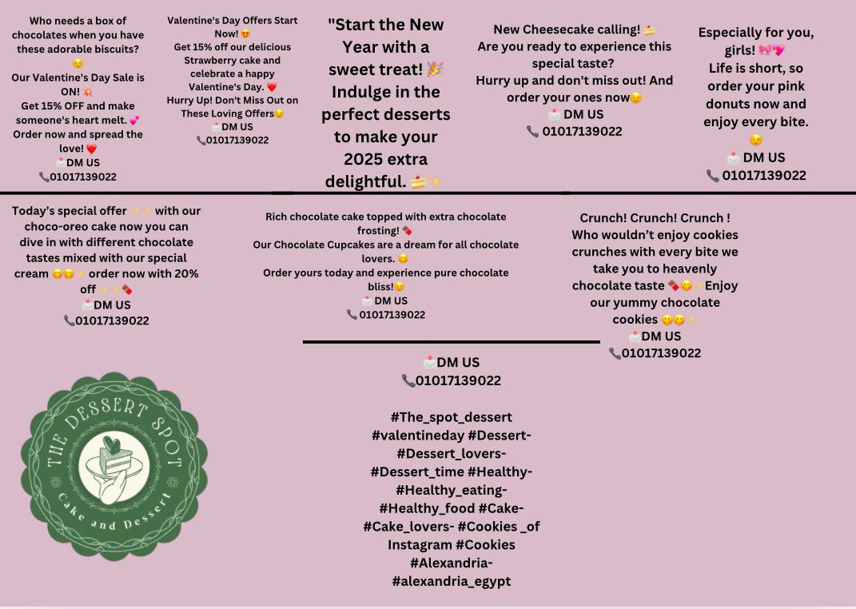
Content calender

Slide 31
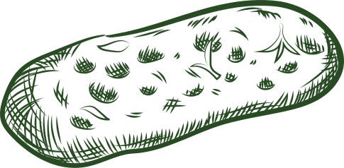
The End
Our Group
Rana Ahmed
Toka Ahmed
Hana Ahmed
Joy Mina
Marwa Omar

